Slide 1


AUBURN UNIVERSITY EMERGENCY MANAGEMENT goals and objectives
Roger Laferriere
Director Emergency Management

Slide 2


Slide 3
National Requirements for emergency management in higher education
The national preparedness elements
National fire protection association (NFPA) 1600
Definition of the organization’s vision, mission, and goals
A risk assessment and business impact analysis (BIA)
A resource needs assessment for:
  emergency operations/response; crisis communications; developing a business continuity standard; actionable recovery plans
Crisis management to address those events that could severely impact:
  the organization’s operations; the brand’s reputation; the market share; its ability to do business; impact on relationships with key stakeholders
Risk Assessment
Estimating Capabilities/Requirements
Building and Sustaining Capabilities
Planning
Exercising
After Action /Follow-up
* Source: PPD 8, National Preparedness, March 30, 2011

Slide 4
Current program and status
Crisis Communication Plan
  Crisis Risk Communications Plan update critical to mitigate catastrophic infodemic impacts. RA will inform areas of focus for other capabilities.
Emergency Operations Plan
  Last update of campus Emergency Operations Plan 2017. Hazard specific plans (Tornado, Hurricanes, Active Shooter) have not been updated since 2021.
    Extend concept of plan ownership from Emergency Manager to AU Leadership. Employ a “Whole of University” approach to socializing plan.
    Department focus can shift to high-risk responses. AU can adopt gold-standard Incident Command System & Incident Management Team concepts.
Business Continuity Plans / Continuity of Operations Plans
  New plan for AU. EM will build the template but will need each department / school to engage and participate in plan development.
Risk Assessment
  Draft updated in October 2024
Estimating Capabilities
  Last conducted in 2015
    With new Risk Assessment complete, can complete capability analysis for highest threats
Building AU Capability
  Continues at local Emergency Responders level. AU new hires bring top notch expertise (Dr. Stewart, Ashley Gann, Roger Laferriere, etc).

Slide 5
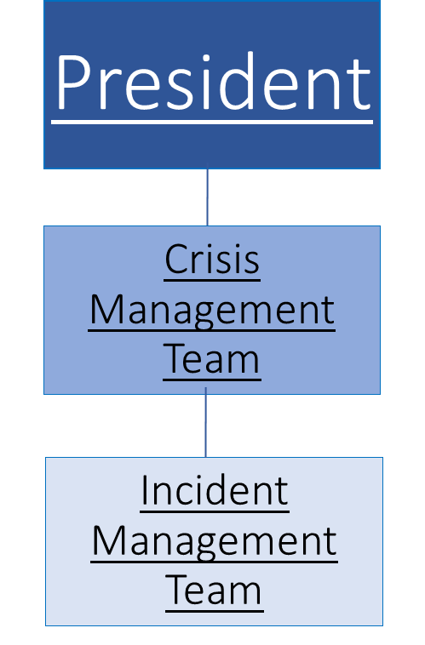
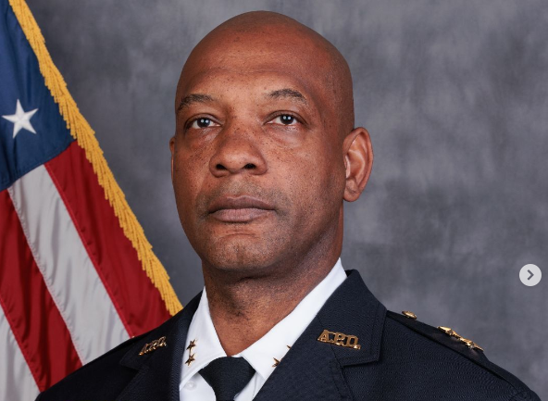
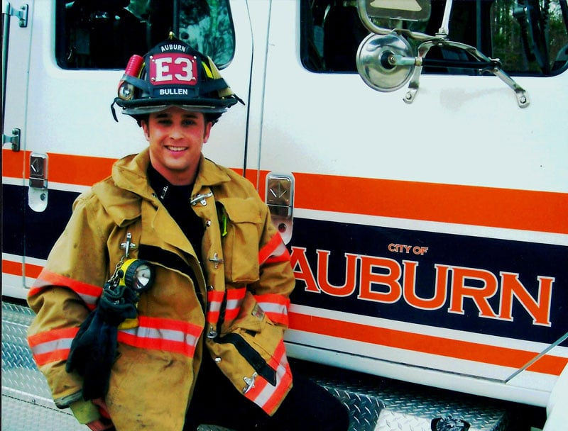
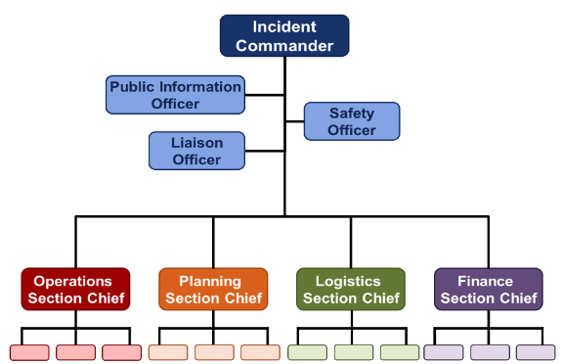
Incident Command system (ICS)
ICS is the gold standard for Emergency Response
  ICS is the model for command, control, and coordination of emergency response at the
  Use of the Incident Command System (ICS) is mandated by presidential directive for all emergency response in the United States.
ICS at AU:

Slide 6
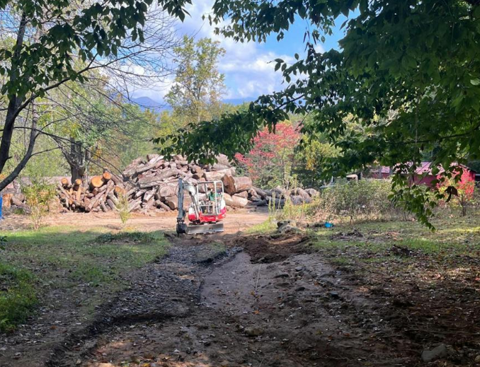
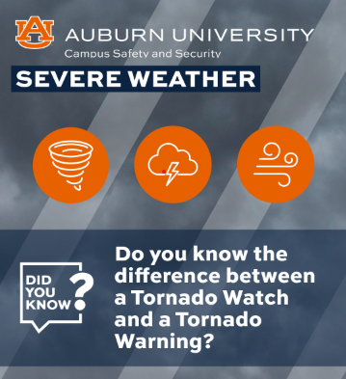
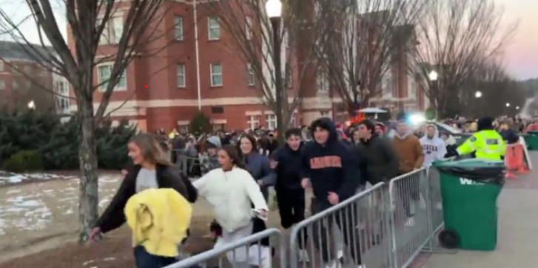

AU Responses this year
Hurricane Helene
4 - Tornado Warnings / Tornado Shelters at Greene Hall and Library
Basketball Crowd Surge Operations
Winter Weather

Slide 7
Whole of university approach to emergency management
Training and Drills:
  Participating in regular training sessions and drills, including active shooter response training, helps staff understand and practice emergency procedures.
Familiarize with Emergency Procedures:
  Knowing the school's emergency procedures, including evacuation routes, assembly points, and communication protocols, is essential.
Understanding Roles:
  Each staff member should understand their specific roles and responsibilities during an emergency, whether it's managing students, assisting with evacuation, or providing first aid.
Responding to Different Situations:
  Faculty and staff should be prepared to respond to various situations, such as fire alarms, active threats, or natural disasters. This includes knowing when to run, hide, or fight, depending on the circumstances.
Communication and Information Management:
  Staying informed about school communication systems (e.g., announcements, emergency notifications) and understanding how to access and share information during an emergency is crucial.
Employee Assistance Programs:
  Familiarizing staff with available Employee Assistance Programs (EAPs) that provide counseling and support services can help manage stress and anxiety related to emergencies.
Continual Improvement:
  Regularly reviewing and updating emergency plans based on lessons learned from drills or real incidents is important to ensure they remain effective.

Slide 8

Next full-scale exercise at AU

Slide 9

Emergency Management Department
  Director, Emergency Management
    Roger Laferriere
    rrl0018@auburn.edu
    (334) 870-9955
  Assistant Director, Emergency Management
    Joe Smith
    jls0260@auburn.edu
    (334) 752-3383
  Training and Exercises
    Charlie Dunn
    csd0007@auburn.edu
For a copy of your building’s Emergency Plan, please e-mail jls0260@auburn.edu
For Emergency Management Training or a request to conduct and exercise, please e-mail csd0007@auburn.edu
  Emergency Management Trainings:
    CPR / First Aid
    Active Threat
    Employee Emergency Preparedness
    C-CERT
    ICS

